Slide 1
Clock Distribution
Introduction

Slide 2
Motivation
Challenges of Clock distribution in multi-GHz systems:
Need to distribute high frequency clock.
Need to drive high capacitive loads.
Need to reduce clock skew & jitter.
Need to reduce the high power consumption. (Conventional methods contain many buffers, so power consumption is high.)
Alternatively, Resonant clock distribution is applied to have better control on clock skew/jitter and reduce the overall power consumption. Electrical resonance occurs when imaginary parts of impedance cancel out at a particular frequency known as resonant frequency. Meanwhile the recycling energy are restored in the on-chip inductors and save the power.

Slide 3
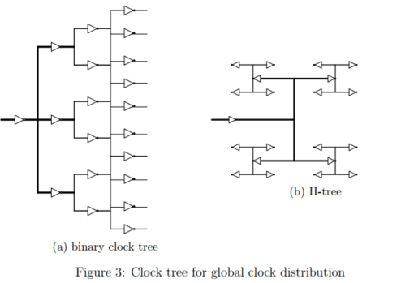
Conventional Clock Distribution
1- Tree:

Slide 4
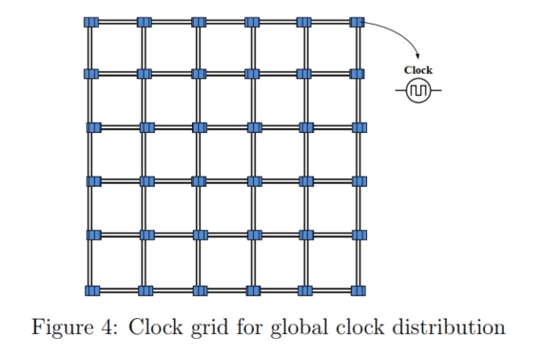
Conventional Clock Distribution
2- Grid:

Slide 5
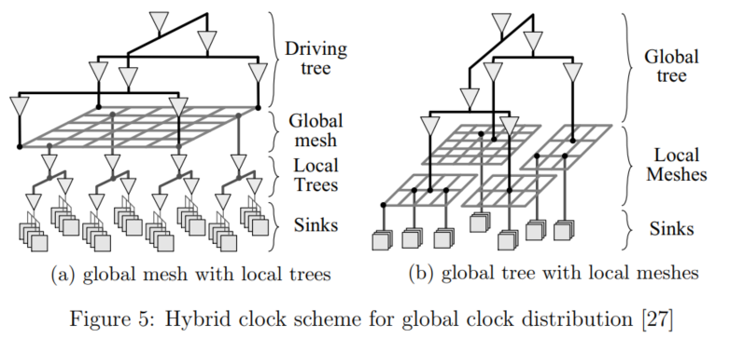
Conventional Clock Distribution
3- Hybrid:

Slide 6
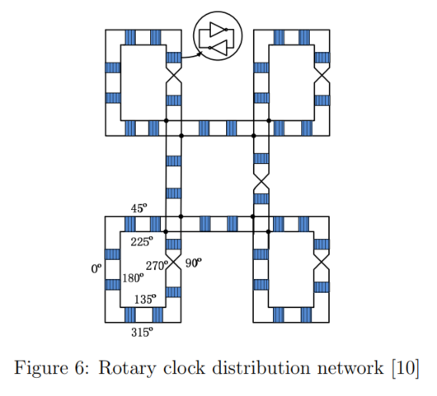
Resonant Clock Distribution
1- Traveling Wave Resonant:

Slide 7
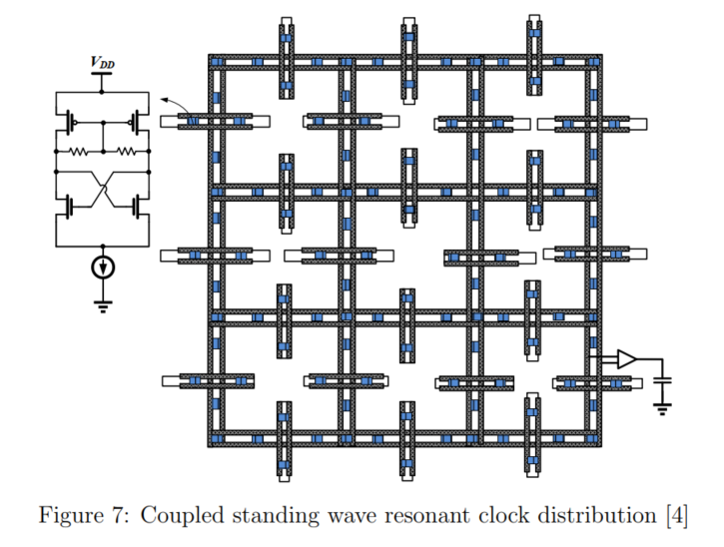
Resonant Clock Distribution
2- Standing Wave Resonant:

Slide 8
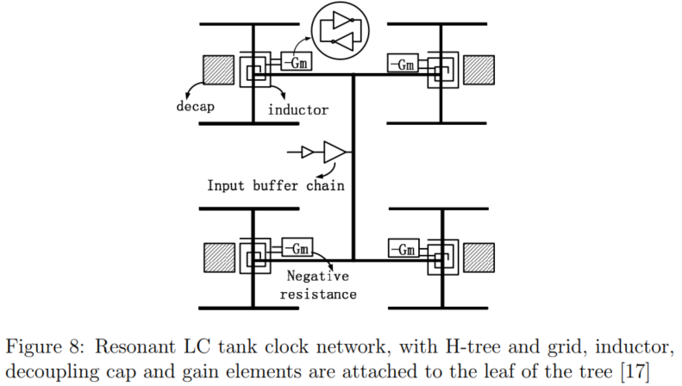
Resonant Clock Distribution
3- LC Tank Resonant:

Slide 9
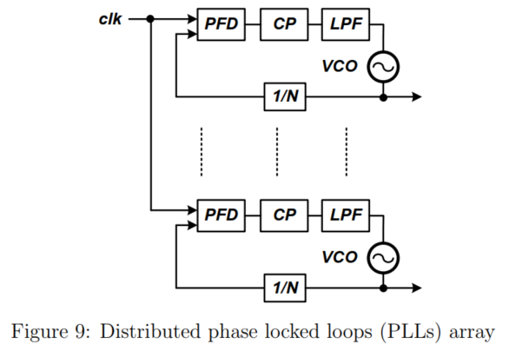
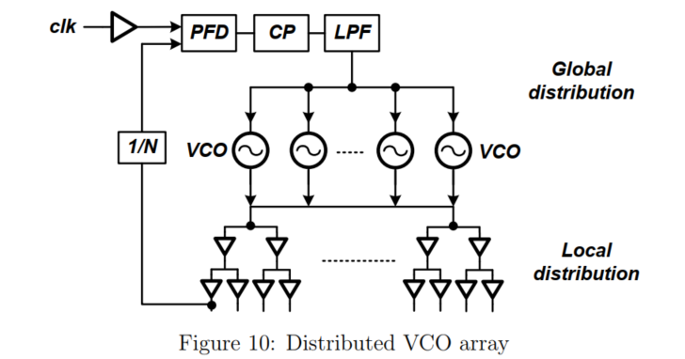
Resonant Clock Distribution
4- Oscillator Array:

